Slide 1



DRAFT OF THE BIOECONOMY STRATEGY UNTIL 2035
Zagreb, February 2024

Slide 2
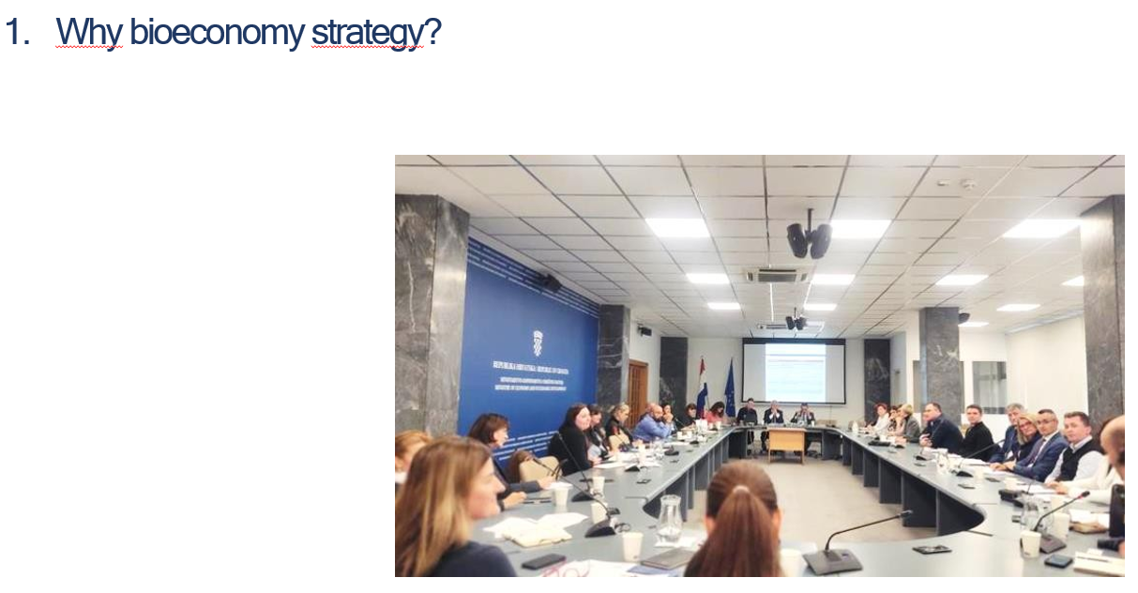
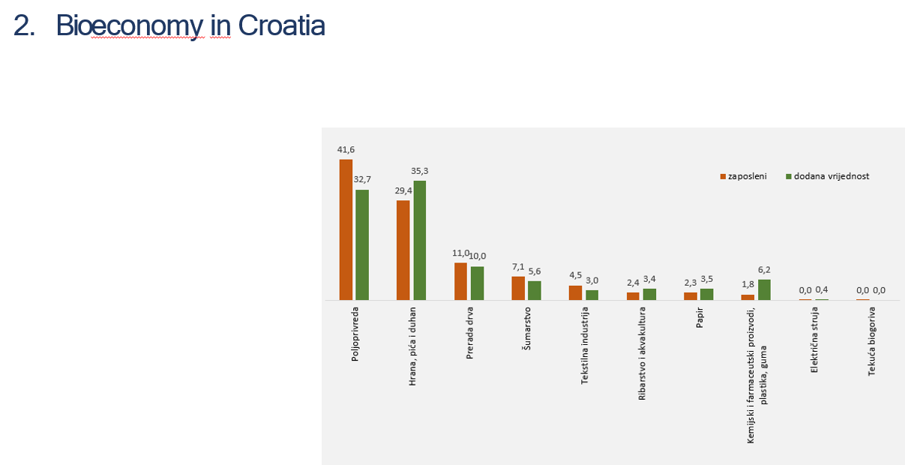
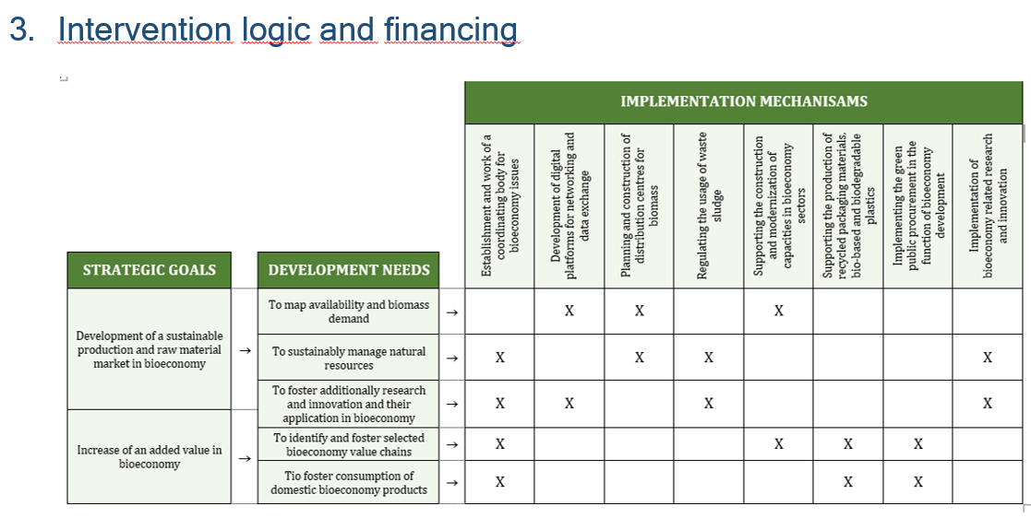
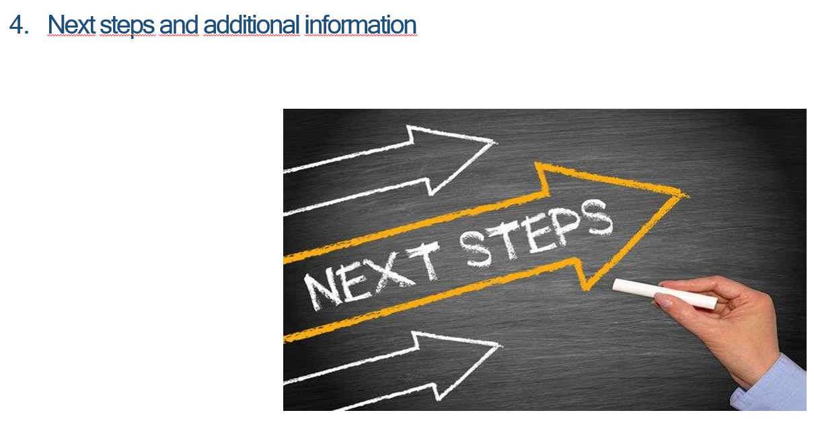
CONTENTS

Slide 3
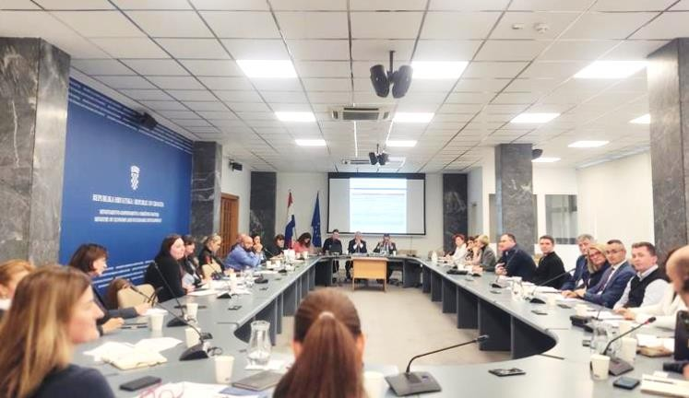
1. Why bioeconomy strategy?

Slide 4

EU BIOECONOMY STRATEGY, 2018
Bioeconomy covers all sectors and systems which are leaning to biological resources (animals, plants, microorganisams and derived biomass including organic waste), their functions and principles.
It includes and interconnects land and marine ecosystems and the services they provide, all primary production sectors that use and produce biological resources, i.e. agriculture, forestry, fisheries and aquaculture; and all economic and industrial sectors that use biological resources and processes to produce food, feed, bio-based products, energy and services.

Slide 5


BIOECONOMY SECTORS
*relates to portion of products based on biological raw materials

Slide 6


National Development Strategy of the Republic of Croatia until 2030
COMMISSION STAFF WORKING DOCUMENT - Commission recommendation for Croatia's CAP strategic plan

Slide 7
Strategic goal 9:
Food self-sufficiency and bioeconomy development
Will be implemented through Bioeconomy strategy
National Development Strategy of the Republic of Croatia until 2030

Slide 8
„Thanks to the rich sources of biomass, Croatia has one of the greatest potentials in the EU for the development of the bioeconomy. However, this potential is currently unused and in recent years even shows certain signs of reduction.”
Recommendation: encourage an increase in the added value of bioeconomy products through investments and financial instruments

Slide 9
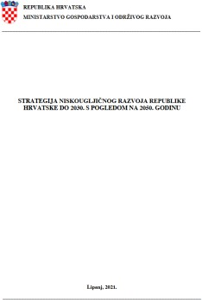

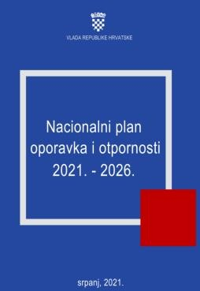
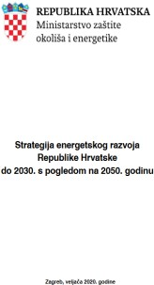
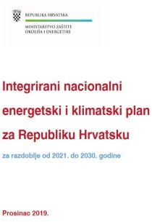

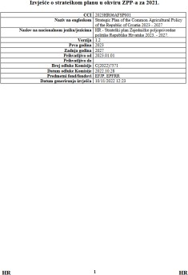
Bioeconomy is partially included in several national strategic and programming documents

Slide 10
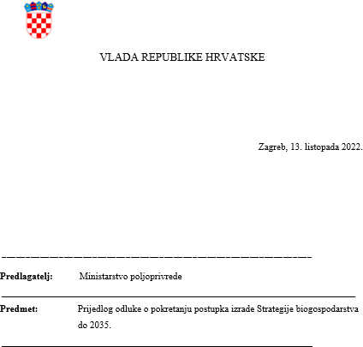
Drafting of the Bioeconomy strategy until 2035
Competent authorities : MA , MESD, MRDEUF, MSE

Slide 11
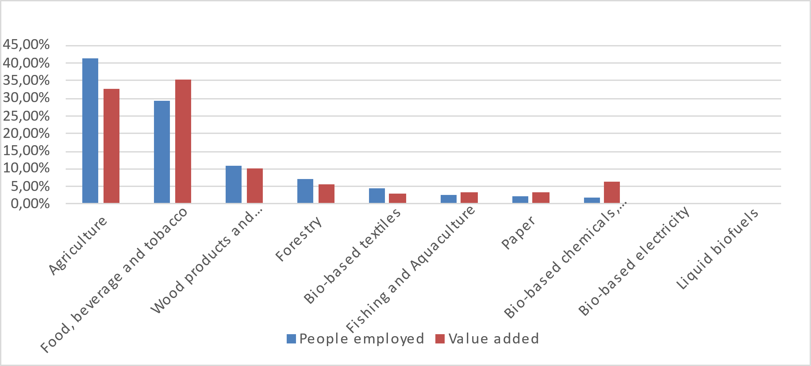
2. Bioeconomy in Croatia

Slide 12


CROATIAN BIOECONOMY STATISTICS
(European Commission assessment, 2020)
Added value of 3,7 bil EUR
≈ 9% GDP of total economy
Employs 203 thousand workers
Productivity of 18.000 EUR per employee
Half of EU productivity average

Slide 13
NUMBER OF EMPLOYED AND VALUE ADDED OF CROATIA’S BIOECOMOMY PER SECTOR (share, %)
41,6
32,7
35,3
Employees
Value added
29,4
11,0_{10,0}
7,1 _{5,6}
4,5
6,2
3,0
_{2,4} 3,4
_{2,3} 3,5
1,8
0,0 0,4
0,0 0,0
Agriculture
Food, beverages, tobacco
Manufacture of wood
Forestry
Textile industry
Fisheries and aquacutlrue
Paper
Chemical and pharma products Plastics, rubber
Elektricity
Liquid biofuels

Slide 14
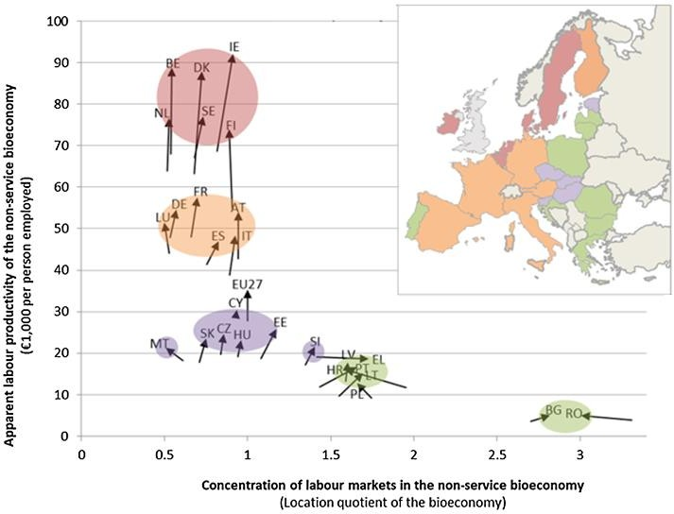

Slide 15




Bioeconomy sectors: food and beverages
Food security – national priority
Growth of production value and labour productivity in agriculture since EU membership
Manufacture of food and beverages is the largest segment of the processing industry in Croatia per GDP share, import and employment
Significant investments in innovation (such as food additives, functional food)

Slide 16
Bioeconomy sectors: biobased products
WOOD MANUFACTURE
Forests cover almost half of Croatia’s land mass
Export oriented sector, although mostly for low processed products
BIOTECHNOLOGY
Long tradition of wide variety products manufacturing
BIOPLASTICS

Slide 17



Bioeconomy sectors: energy from biomass
Registered:
20 biogas power plants
38 biomass electric plants
Integrated National Energy and Climate Plan until 2030:
50,3%
Share in total energy consumption from renewable resources
2,4x
Production increase electricity from biomass
2,3x
Increase in usage of transport biofuels

Slide 18

Bioeconomy sectors: research and innovation
Intensive research activity
Financing through Horizon Europe, smaller portion through Competence and Cohesion Programme
Study programmes or subjects on several Croatian faculties

Slide 19
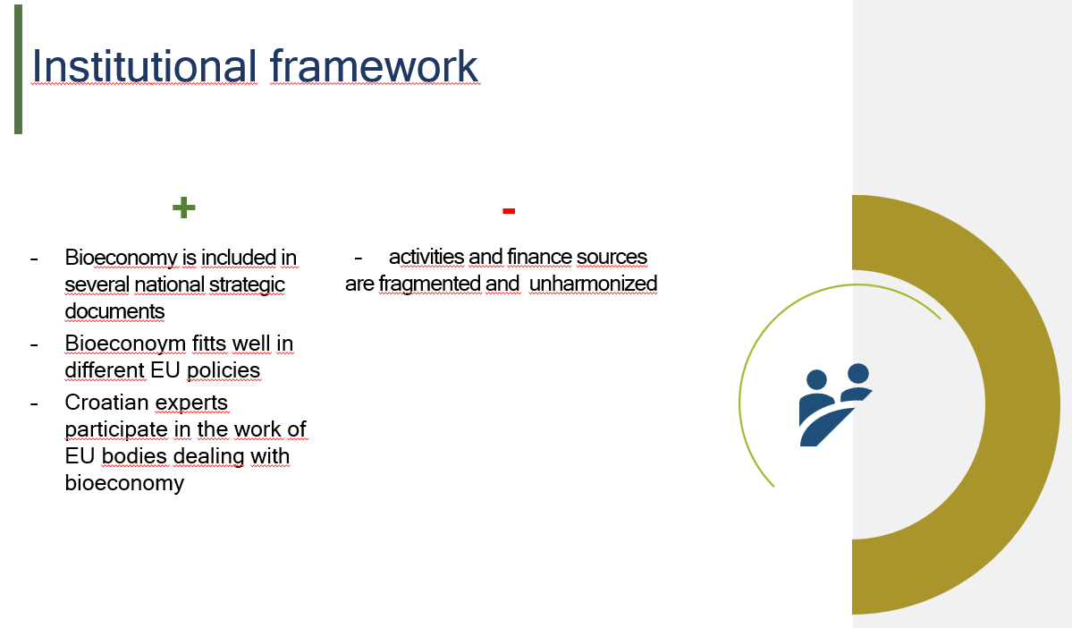
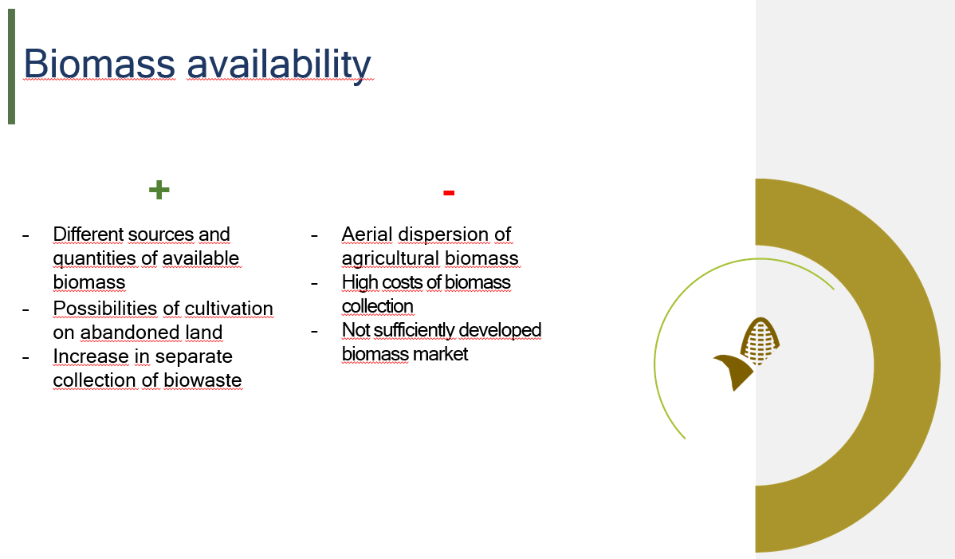
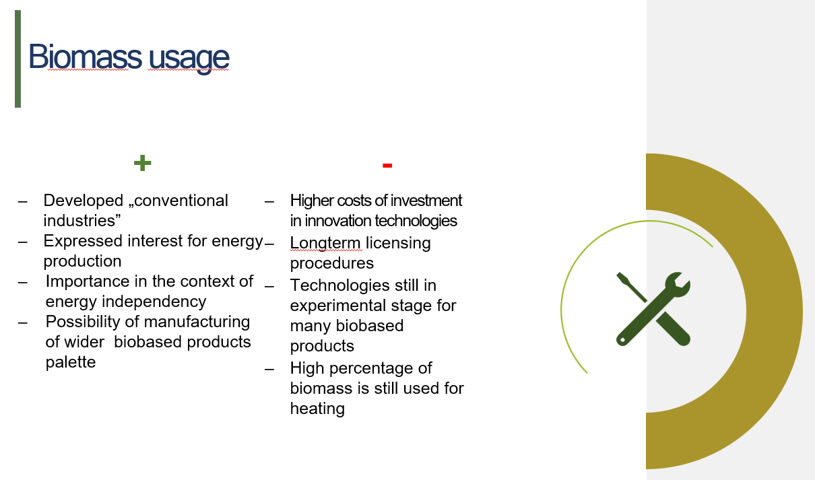
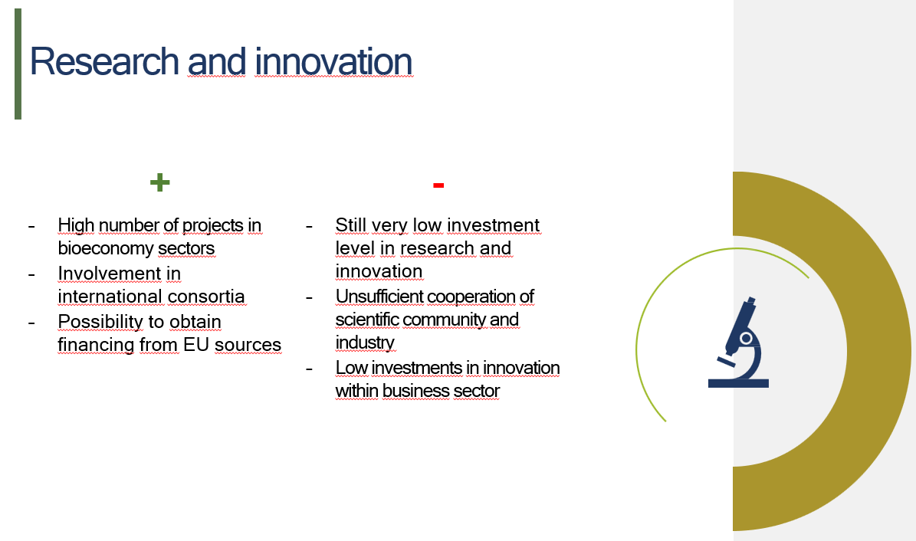
SWOT analysis of Croatian bioeconomy

Slide 20


Institutional framework
+ | -
Bioeconomy is included in several national strategic documents Bioeconomy fitts well in different EU policies Croatian experts participate in the work of EU bodies dealing with bioeconomy | activities and financing sources are fragmented and unharmonized

Slide 21

Biomass availability
+ | -
Different sources and quantities of available biomass Possibilities of cultivation on abandoned land Increase in separate collection of biowaste | Aerial dispersion of agricultural biomass High costs of biomass collection Biomass market not sufficiently developed

Slide 22
Biomass usage
+ | -
Developed „conventional industries” Expressed interest for energy production Importance in the context of energy independency Possibility of manufacturing of wider biobased products palette | Higher costs of investment in innovation technologies Long-term licensing procedures Technologies still in experimental stage for many biobased products High percentage of biomass is still used for heating

Slide 23
Research and innovation
+ | -
High number of projects in bioeconomy sectors Involvement in international consortia Possibility to obtain financing from EU sources | Still very low investment level in research and innovation Unsufficient cooperation of scientific community and industry Low investments in innovation within business sector

Slide 24
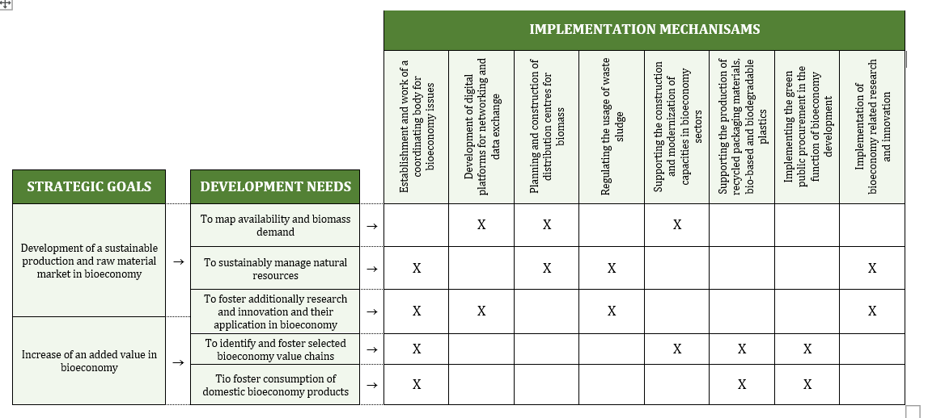
3. Intervention logic and financing

Slide 25

VISION OF BIOECONOMY DEVELOPMENT
Bioeconomy until 2035 aims to rapidly develop as dynamic and diversified activity, which significantly contributes to overall economic activities in Croatia and their sustainability, being especially significant for rural areas along with the decrease of Croatia’s dependence on non-renewable raw material sources.

Slide 26
5 DEVELOPING NEEDS
1. To map availability and demand for biomass
2. To manage sustainably natural resources
3. To additionally foster scientific and research activities and innovation as well as their usage in bioeconomy
4. To identify and foster selected bioeconomy value chains
5. To foster consumption of domestic bioeconomy products
8 IMPLEMENTATION MECHANISMS
1. Establishment and work of the coordinating body for bioeconomy issues
2. Development of digital platforms for networking and data exchange
3. Planning and construction of distribution centres for biomass
4. Regulating the usage of waste sludge
5. Supporting the construction and modernization of capacities in bioeconomy sectors
6. Supporting the production of recycled packaging materials, bio-based and biodegradable plastics
7. Implementing the green public procurement in the function of bioeconomy development
8. Implementation of bioeconomy related research and innovation
2 STRATEGIC GOALS
1. Development of a sustainable production and raw material market in bioeconomy
2. Increase of an added value in bioeconomy

Slide 27
FINANCING POSSIBILITIES
PROGRAMMES:
Competitivness and Cohesion Programme 2021.-2027.
Integrated Territorial Programme 2021-2027
Strategic Plan of the Common Agricultural Policy of the Republic of Croatia 2023 – 2027
Modernisation Fund
The Enviromental Protection and Energy Efficiency Fund
THEMES:
strengthening research and innovation capacities
growth and competitiveness of SMEs
circular and resource efficient economy
food and agriculture
green and blue growth
renewable energy sources
forestry measures
EIP operational groups
LEADER approach support
climate neutrality
energy efficiency

Slide 28


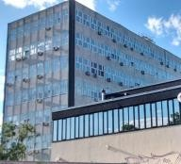
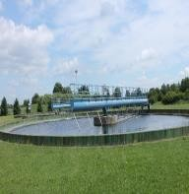
EXAMPLES OF STRATEGIC PROJECTS
Treatment of grape and olive pomace
R&I BioPark for livestock production and biotechnology
Center of Excellence in Biotechnology and Food Engineering
Facilities for the treatment of biowaste and sludge from wastewater treatment plants

Slide 29

4. Next steps and additional information

Slide 30



NEXT STEPS:
EX ANTE EVALUATION
→In progress
STRATEGIC EVALUATION OF ENVIRONMENTAL IMPACT ASSESMENT
→ In progress
OFFICIAL ADOPTION PROCEDURE
→During 2024

Slide 31
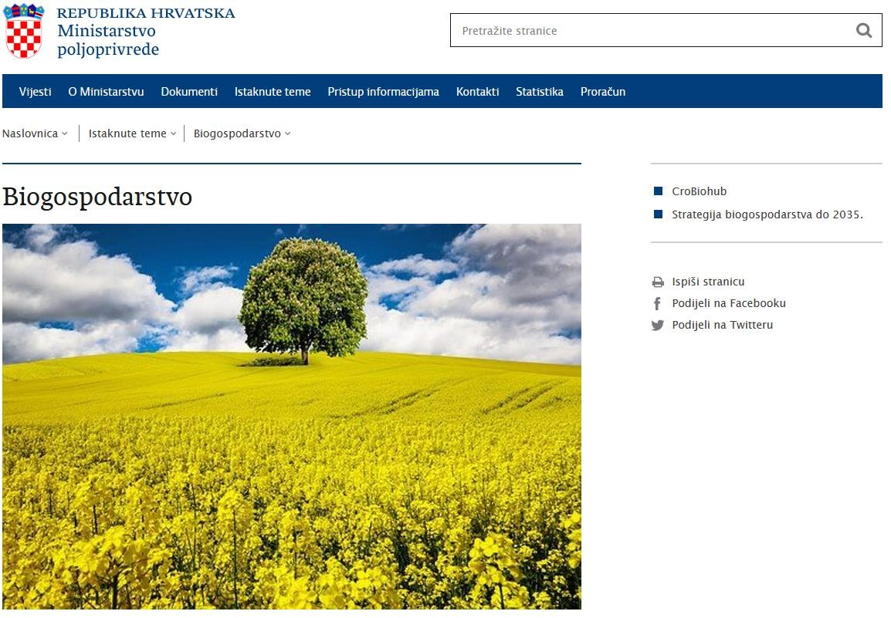
MORE INFO

Slide 32
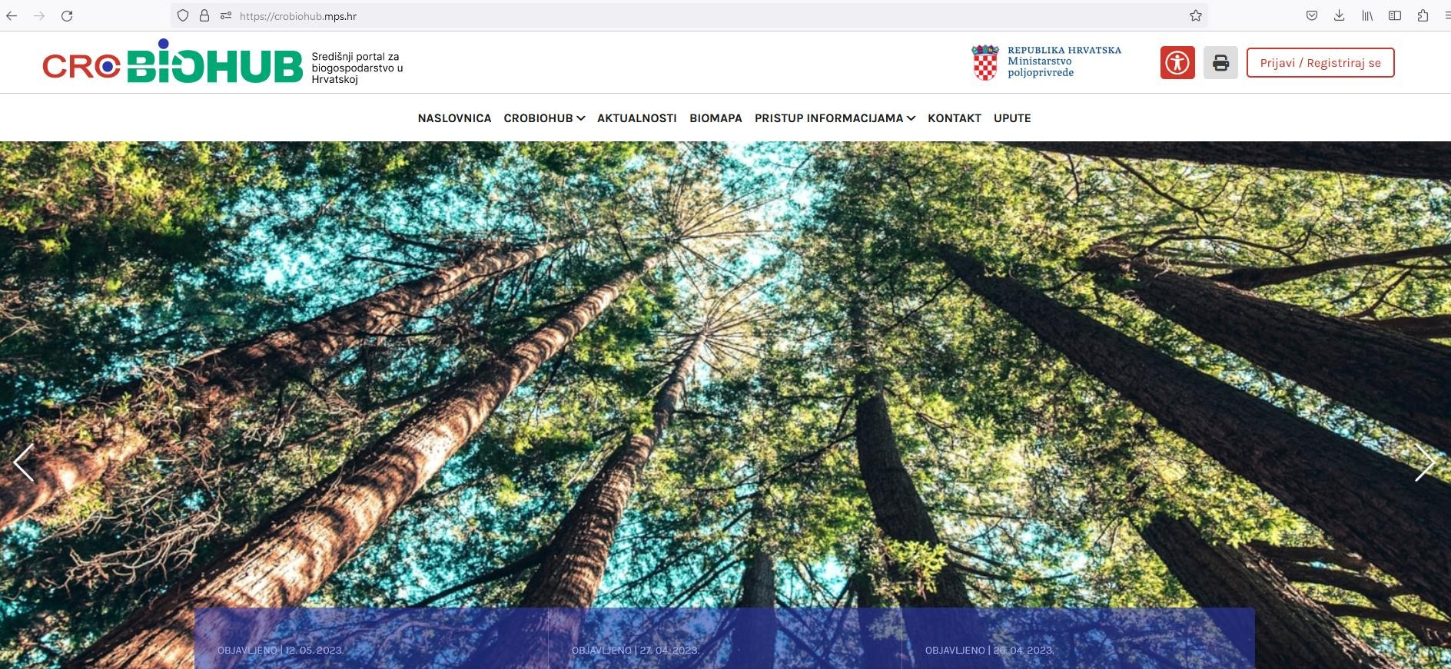

Slide 33



https://poljoprivreda.gov.hr/biogospodarstvo/4647

